Slide 1

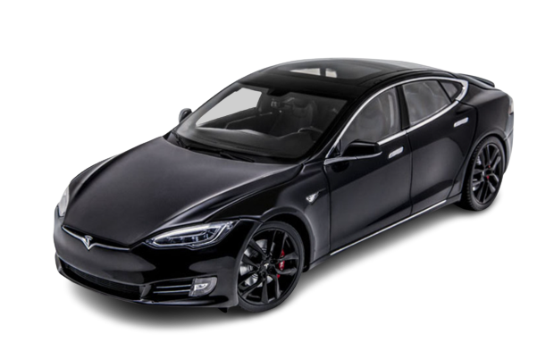
Web Scraping Project On
Richa Sharma
Sree Yadlapalli

Slide 2

Web Scraping Pseudo Code
📚 Import Libraries
🔗 Take a Carpages URL as input
🛠️ Get the request from the server via HTTP.
🍲 Create the soup using BS4
📄 Extract the company description and specialties
🖥️ Extract the website , type, founded, industry, and company size if they exist ,otherwise set them to “N/A”
🗑️Clean up the rest of the data
📊 Output to CSV
⏰ Sleep some random number of seconds & milliseconds

Slide 3




GOALS
To help consumers make informed decisions by comparing prices of different cars and identify patterns in the pricing of different makes and models.
To understand the distribution of used cars in Canadian geography.
To identify factors affecting the price of used cars.
To understand the distribution of share of each auto maker in the used car market.

Slide 4
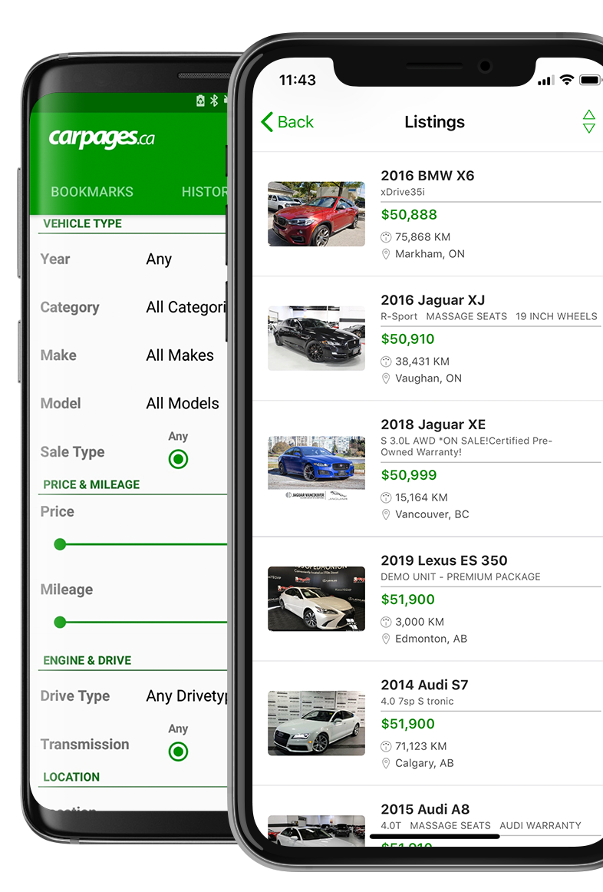

Company Overview
Websites https://www.carpages.ca (B2C), https://dealers.carpages.ca (B2B)
Founded 2004
Industry Used Cars
Services Digital Marketing
Headquarters Mississauga, ON
Portfolio 75000 Cars
Partnership Over 1000 dealers across Canada
Revenue $5.5M

Slide 5
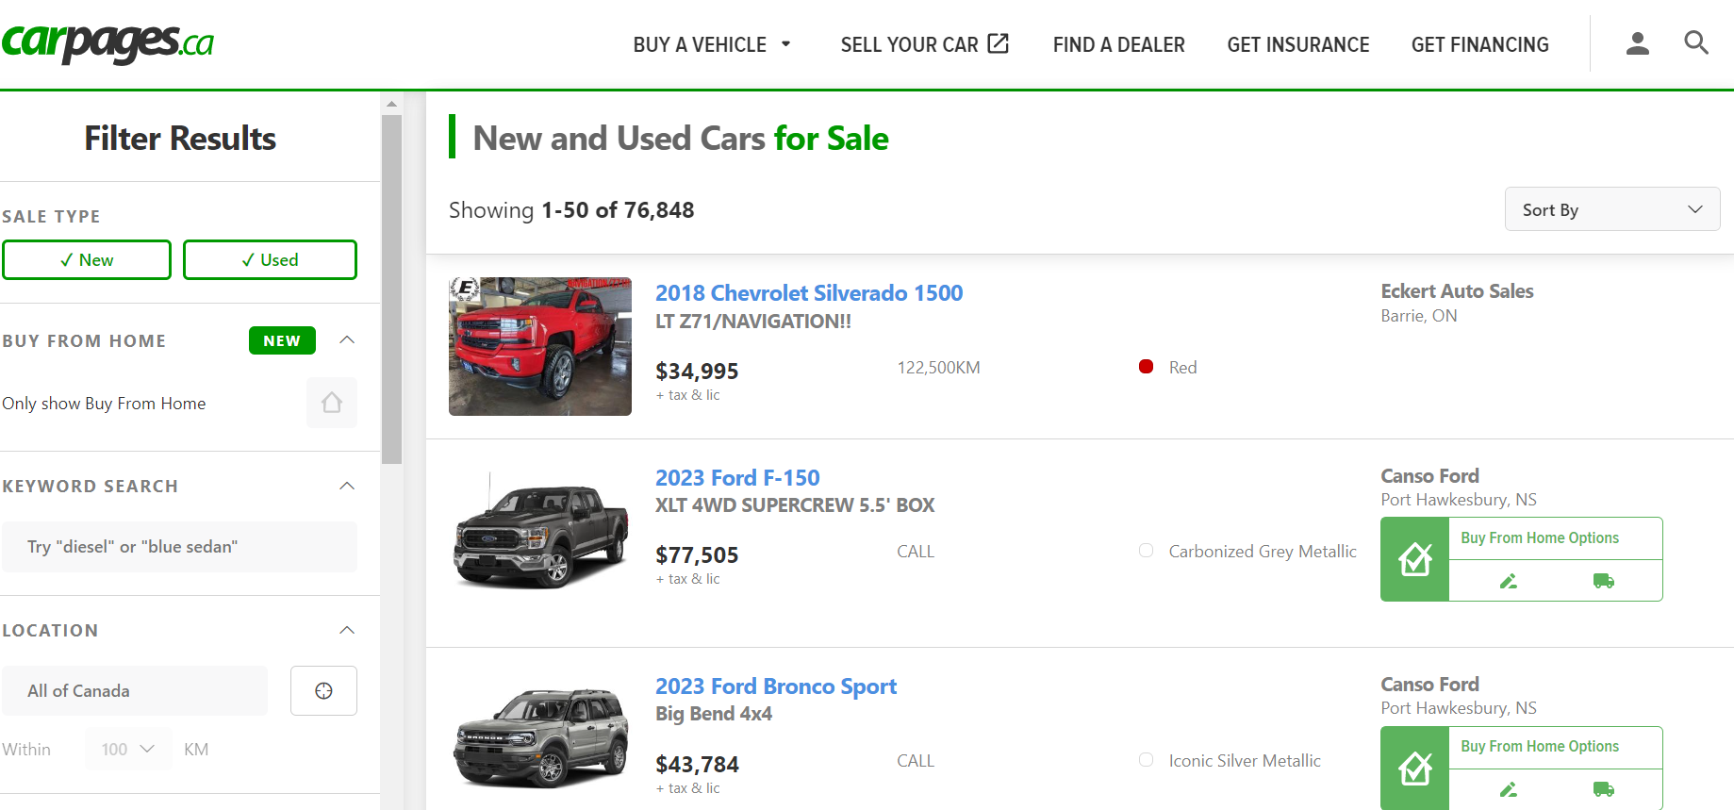
Website Navigation
Navigating the website

Slide 6
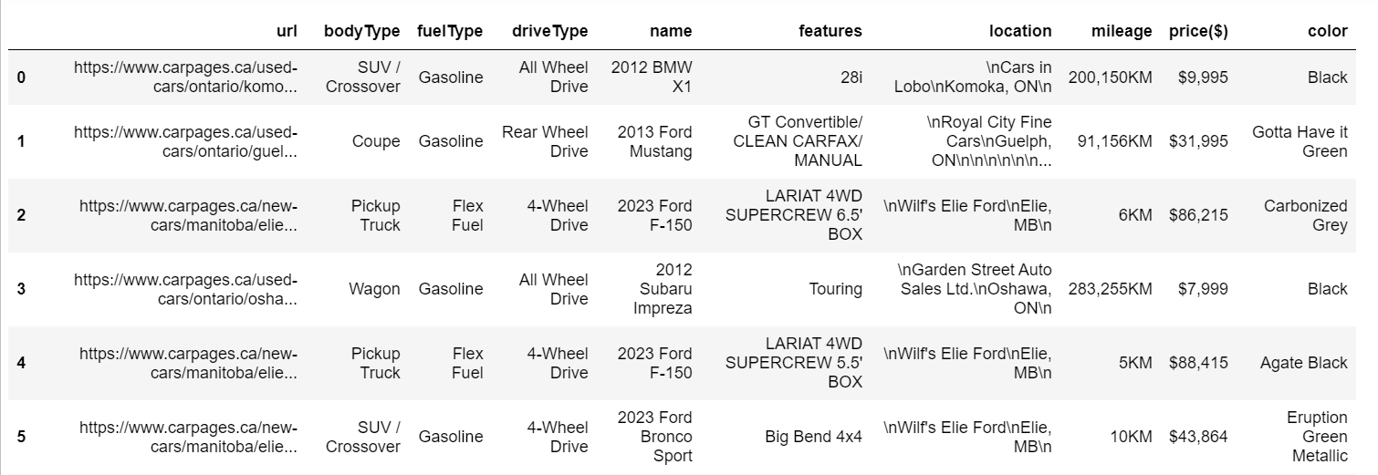
Raw Data frame
Total listings recorded: (4949, 10)
Total pages scrapped: 100

Slide 7
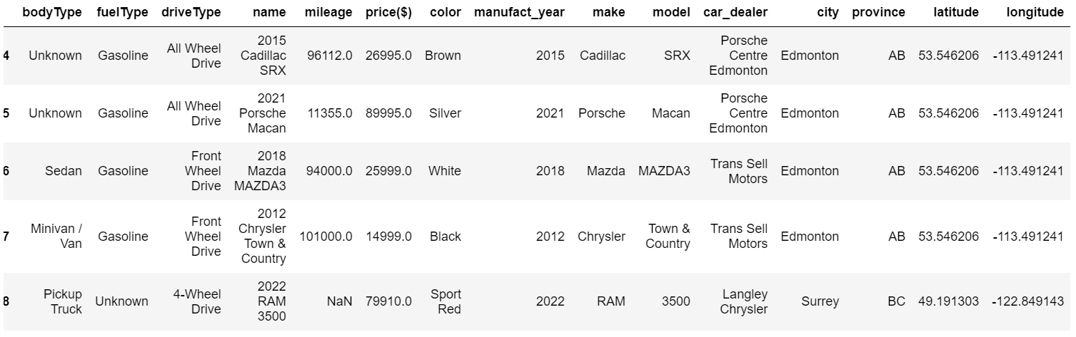
Processed Data Frame
Additional Columns included: [Province, City, Make, Model, Longitude, Latitude]
Dropped Columns: URL , Location , Features

Slide 8
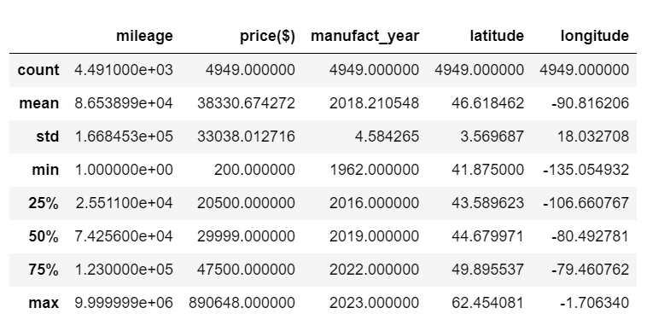
Statistical Measure With Outliers
Mileage has a minimum value of 1 km, indicating that the car is barely used.
Statistical analysis revealed that the maximum mileage was exceeding its upper bound.

Slide 9
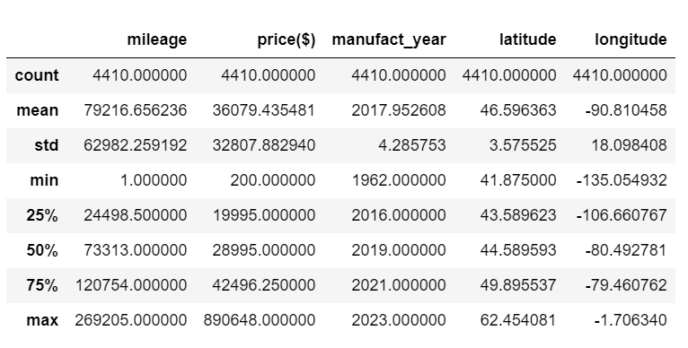
Statistical Measure Without Outliers
1962 Chevrolet Corvette is a vintage car which cannot be considered as an outlier.
2022 Lamborghini Aventador is the car with higher price.

Slide 10
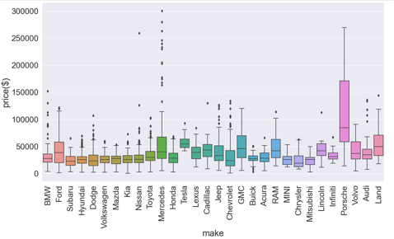
Price Distribution of Each Car Maker
The box plot depicts the price distribution of each car maker.
It can be observed that the luxury brands like Mercedes and Porsche have extreme high prices.
The legacy automakers have consistent price distribution with minimal outliers.
It can also be observed that the car brands will make a great impact on predicting resale prices.

Slide 11
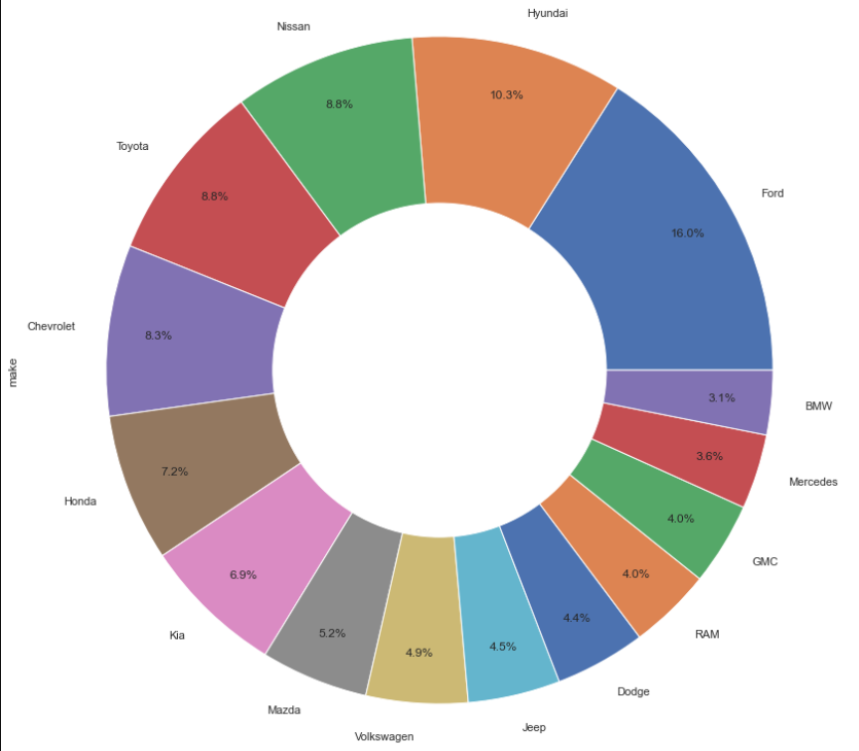
Top 15 Car Makers in Used Car Market

Slide 12
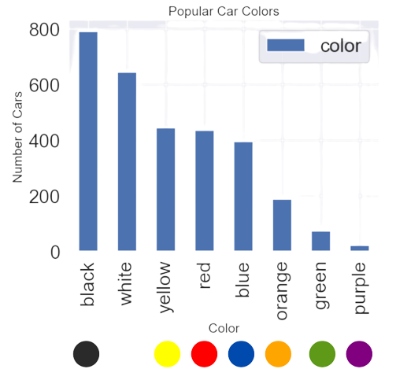
Popular Colors In The Used Car Market

Slide 13
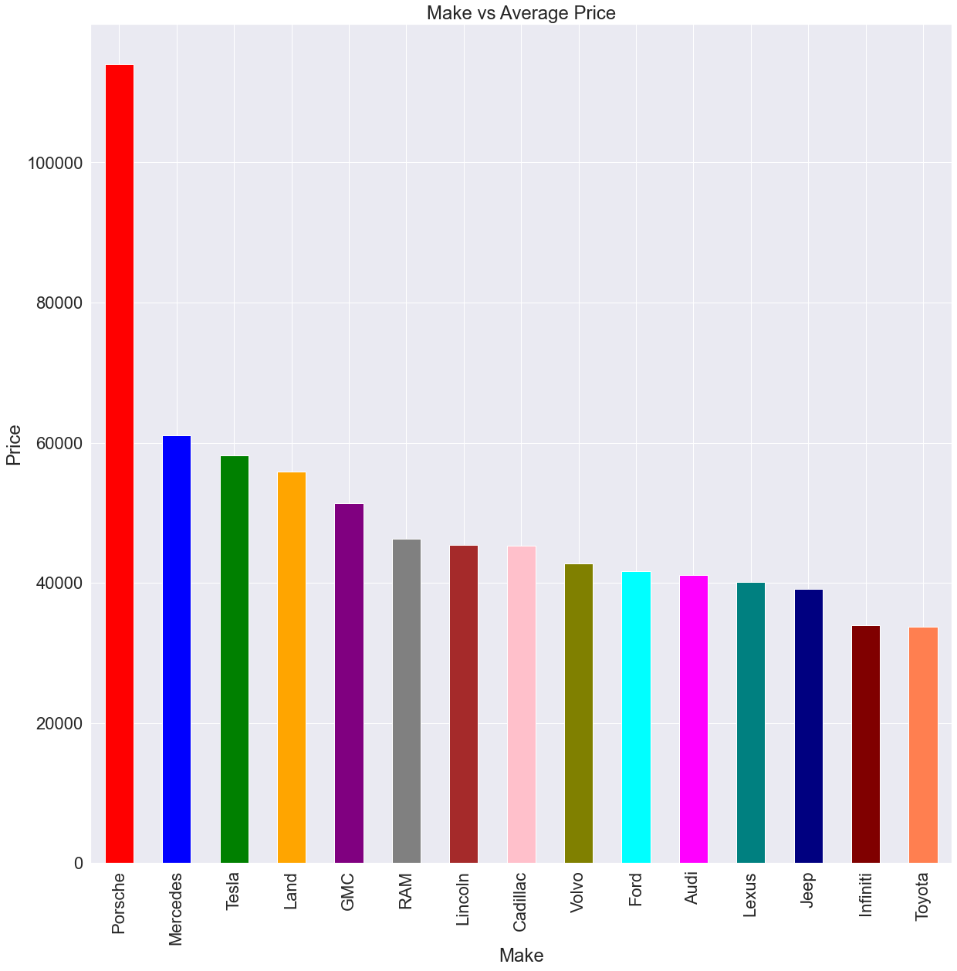
Average Price of Used Car for Each Car Maker

Slide 14
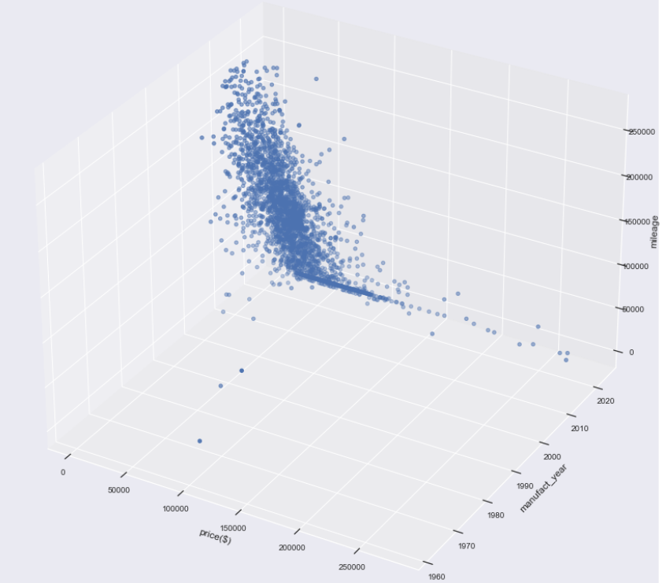
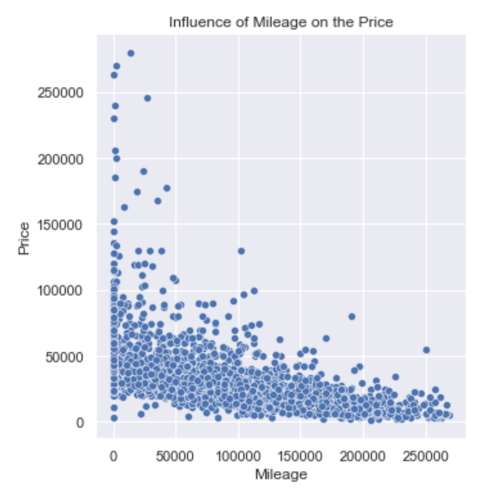
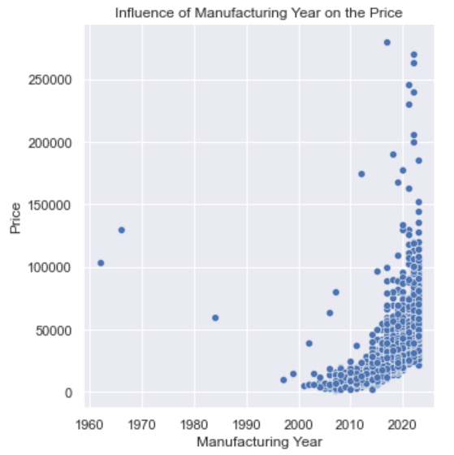
Influence of Mileage & Year on Price
The price of the used car is inversely proportional to the mileage and year of the car.
However , certain vintage cars from the 1980s to 1990s still hold value in the used car market.

Slide 15
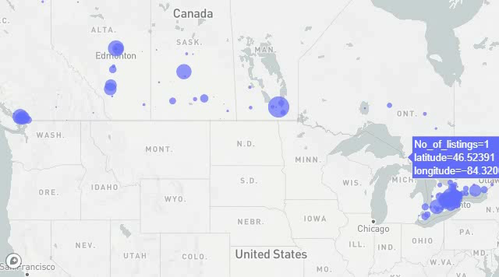
Geographical Distribution of Cars

Slide 16
Conclusions
Moderate correlation is seen in ( mileage, price) and ( manufacturing year ,price)
69% of the listings constitute of gasoline cars.
SUV/Crossover body type constitute 35% of the total listings.
13% of the used car share is comprised of cars from 2019.
Co

Slide 17
Challenges
Due to the dynamic content on autotrader.ca, data cannot be scrapped effectively as HTML elements are updated periodically.
Missing children tags on carpages.ca.
Data in mileage and price columns contain abnormal strings such as 'CALL' and 'KM’.
To identify geographical distribution of cars, geopy.geocoder module was used.
To normalize car colors, difflib.SequenceMatcher was used.

Slide 18

Next Steps
Scrape more data for additional listings.
Increased sample sizes to train the models.
Possibly utilize regression model to predict the price of the model.
Steps might also include scrapping from other websites to check the performance of the model.

